Slide 1
HW1-Matrix Multiplication
First, input m, n, p, which is the dimension of two matrix, A_{m*n}, B_{n*p}，then, input the two matrices respectively with row major. Finally, output the multiplication of A and B.
input: m, n, p(max dimension is 10), two matrices(A, B)
output: A*B

Slide 2
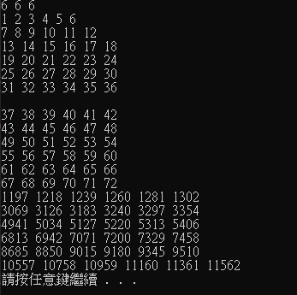
HW1-Matrix Multiplication

Slide 3
HW2-Position
Determine the positions of each letter in a given string
input: a string containing only english characters (capitalized and not capitalized)
output: the positions of each letter in order a~z, then A~Z

Slide 4
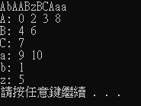
HW2-Position

